Slide 1
Equipment identification through image recognition
Master thesis, final seminar
Author: Saidnassimov Darkhan
Supervisor: Prof. Alexander Ilin
Advisor: Dr. Christian Binder

Slide 2
Introduction
Problem definition
Computer vision has been gaining popularity in numerous fields
Less research has addressed industrial applications
Industrial plants contain thousands of equipment parts
The process of identifying these objects delays the production
Optimizing the production at all stages is important
Many of the existing object detection methods require a vast amount of data, which is often impossible in industrial plants

Slide 3
Introduction
Thesis objectives
To identify a suitable state-of-the-art object detection technique
To enhance its performance on the custom equipment dataset
To identify an object in a real image given a labeled dataset of rendered images from a 3D model and a smaller unlabeled dataset of real images
To facilitate the data collection and labeling process
To address scalability of the system
To develop a proof-of-concept application

Slide 4
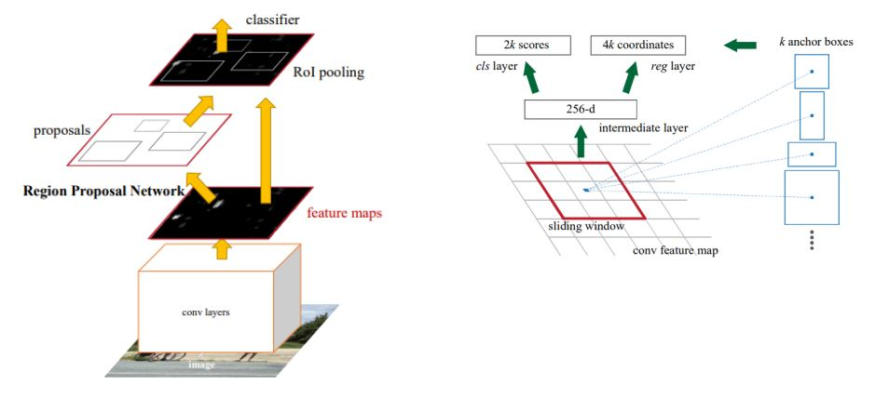
Background
Object detection, Faster-RCNN
S. Ren, K. He, R. Girshick, and J. Sun, “Faster r-cnn: Towards real-time object detection with region proposal networks,” June 2015.

Slide 5
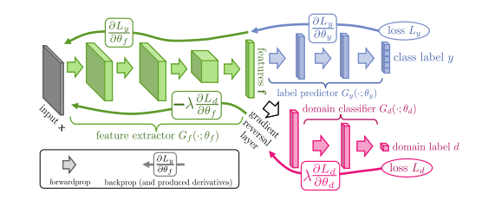
Background
Domain Adaptation, GRL
Y. Ganin, E. Ustinova, H. Ajakan, P. Germain, H. Larochelle, F. Laviolette, M. Marchand, and V. Lempitsky, “Domain-adversarial training of neural networks,” Journal of Machine Learning Research 2016, vol. 17, p. 1-35, May 2015.

Slide 6
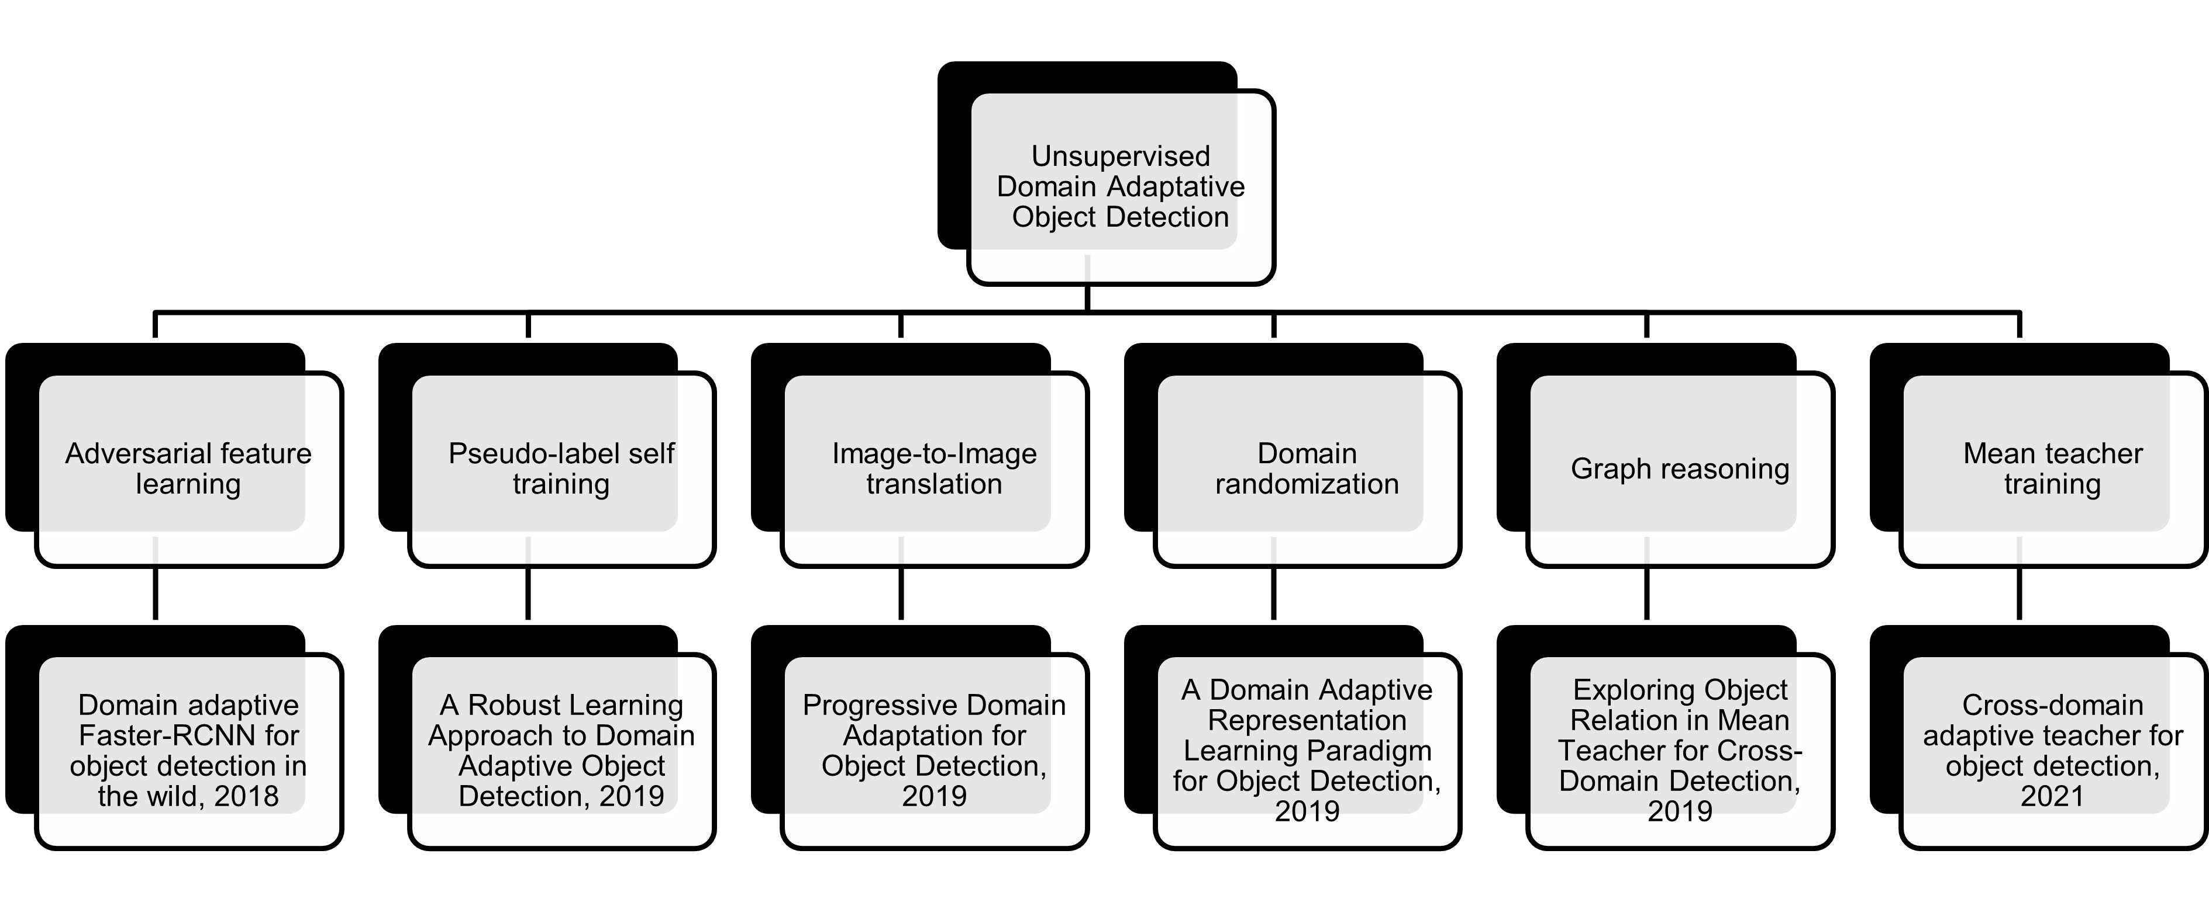
Background
Domain-adaptive object detection

Slide 7
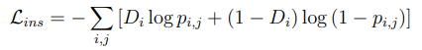
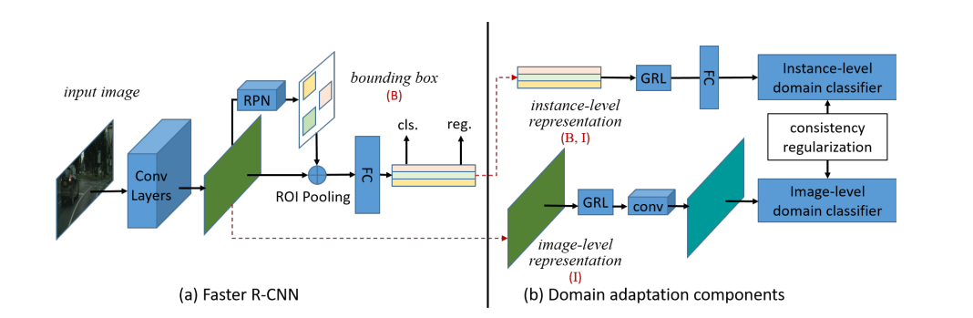
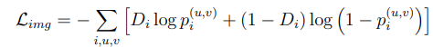
Background
Cross-domain adaptation, Faster-RCNN in the Wild
Y. Chen, W. Li, C. Sakaridis, D. Dai, and L. V. Gool, “Domain adaptive Faster-RCNN for object detection in the wild,” Mar. 2018

Slide 8
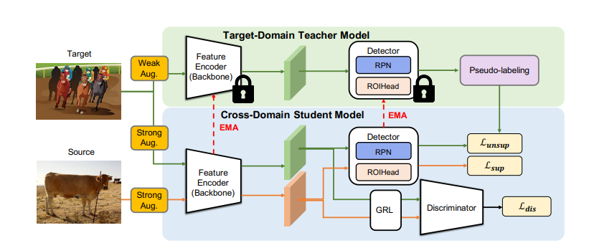
Background, Domain Adaptation
Cross-domain adaptation, Adaptive teacher
Y.-J. Li, X. Dai, C.-Y. Ma, Y.-C. Liu, K. Chen, B. Wu, Z. He, K. Kitani, and P. Vajda, “Cross-domain adaptive teacher for object detection,” Nov. 2021.

Slide 9
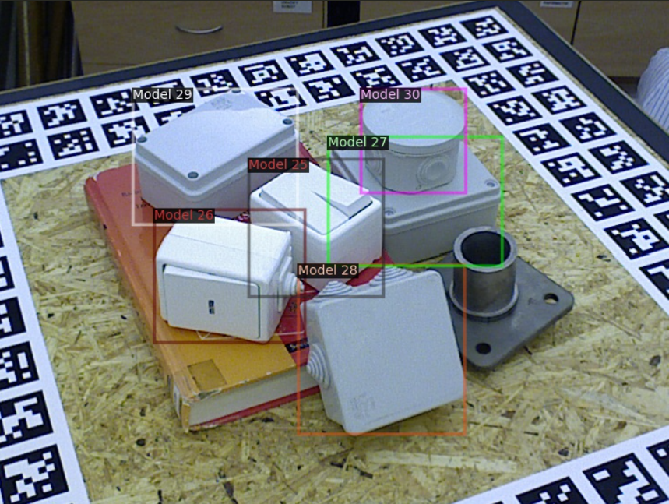
Methodology
Dataset, T-LESS
Originally developed for 6D pose estimation
The dataset consists of two subsets with real and rendered images of industry-relevant equipment
Objects are often roughly identical to each other
T. Hodaň, P. Haluza, Š. Obdržálek, J. Matas, M. Lourakis, and X. Zabulis, “T-LESS: An RGB-D dataset for 6D pose estimation of texture-less objects,” IEEE Winter Conference on Applications of Computer Vision (WACV), 2017.

Slide 10
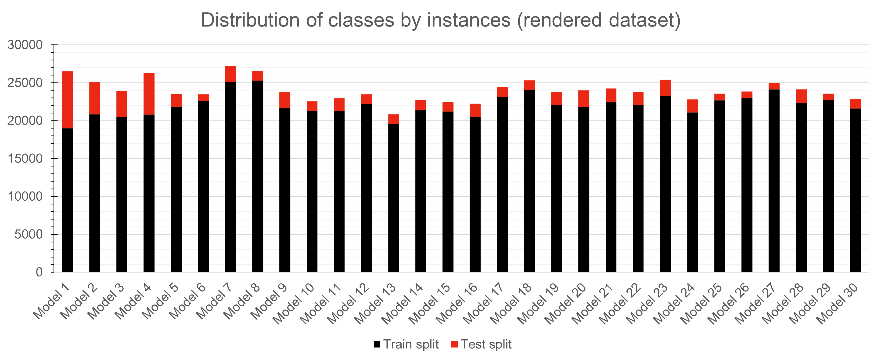
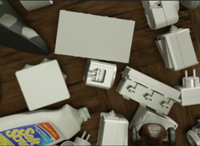
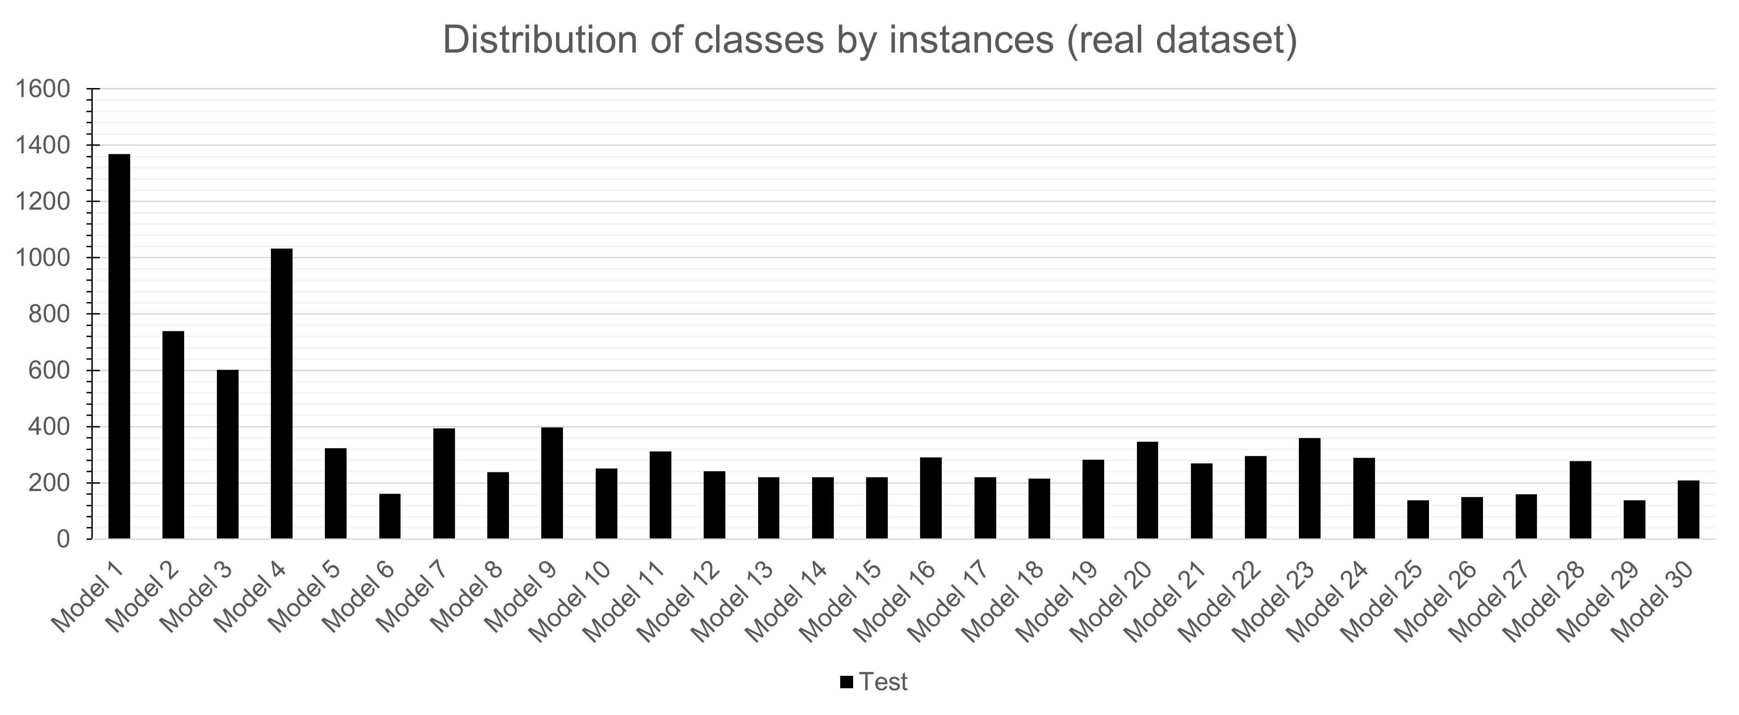
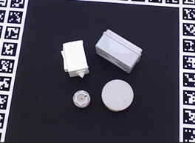
Methodology
Dataset
Source (rendered) dataset
Target (real) dataset

Slide 11
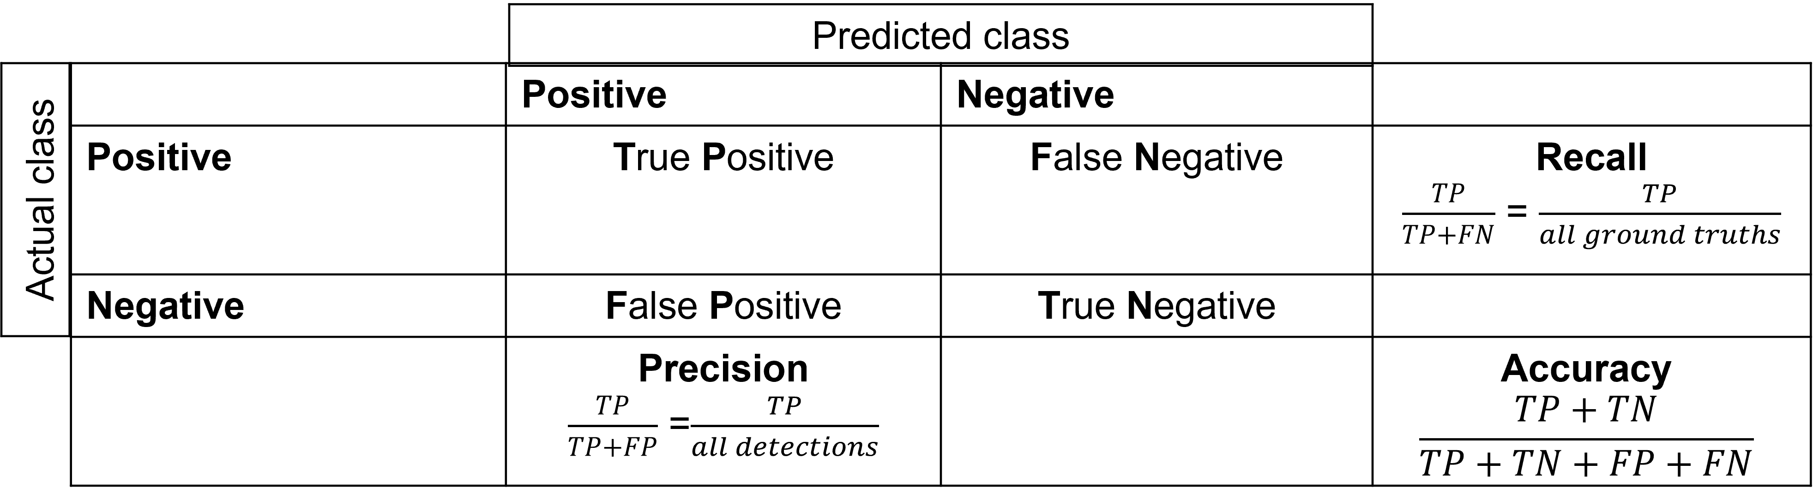
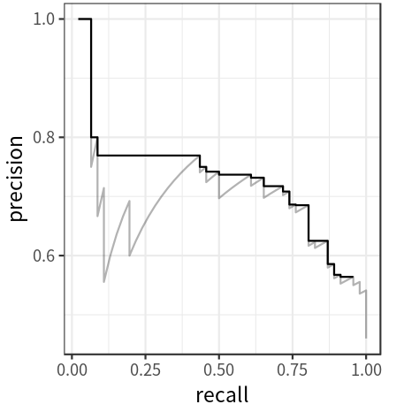
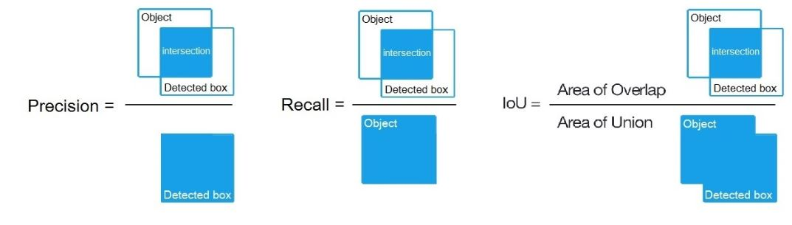
Methodology
Metrics
Same as the standard Pascal VOC 2010-2012 metric
mAP@0.5 = AP50
IoU
AUC
How to calculate mAP for detection task for the PASCAL VOC Challenge

Slide 12
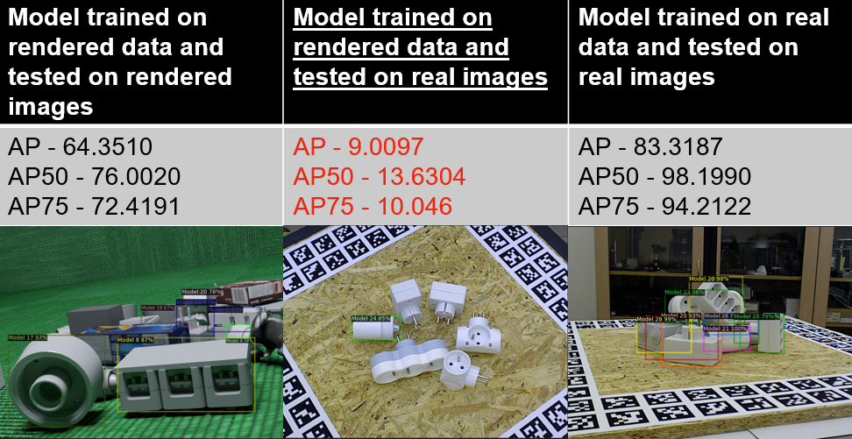
Methodology
Naive approach

Slide 13
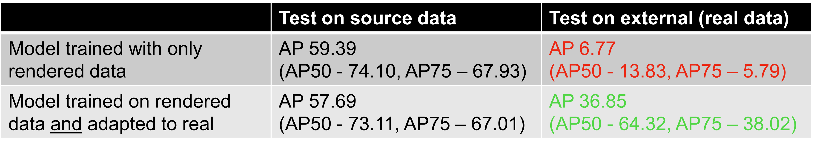
Methodology
D-Adapt

Slide 14
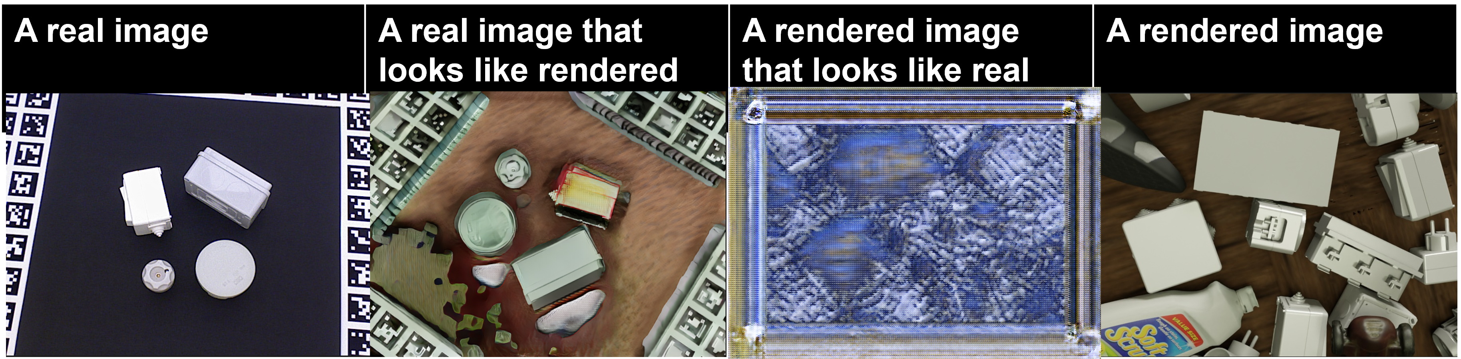
Methodology
Cycle-GAN

Slide 15
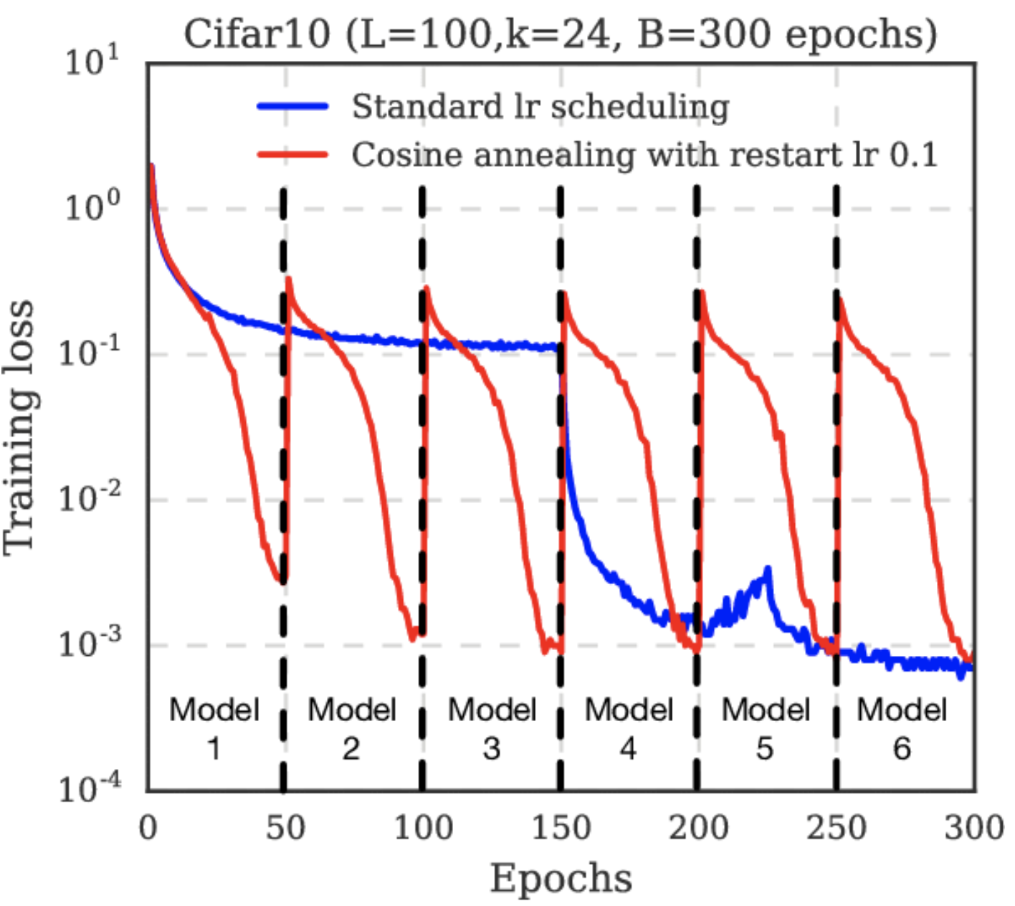
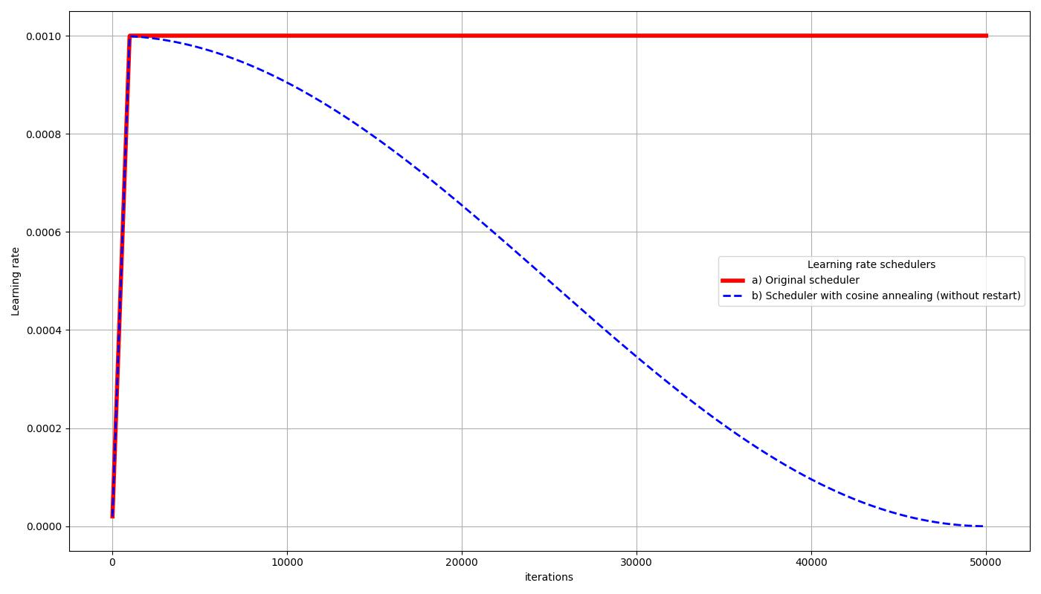
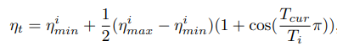
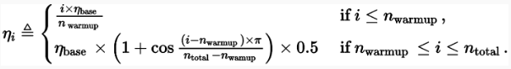
Methodology
Adaptive teacher with an adjusted scheduler
Original cosine annealing with restarts
Cosine annealing without restarts
I. Loshchilov and F. Hutter, “Sgdr: Stochastic gradient descent with warm restarts,” Aug. 2016.

Slide 16
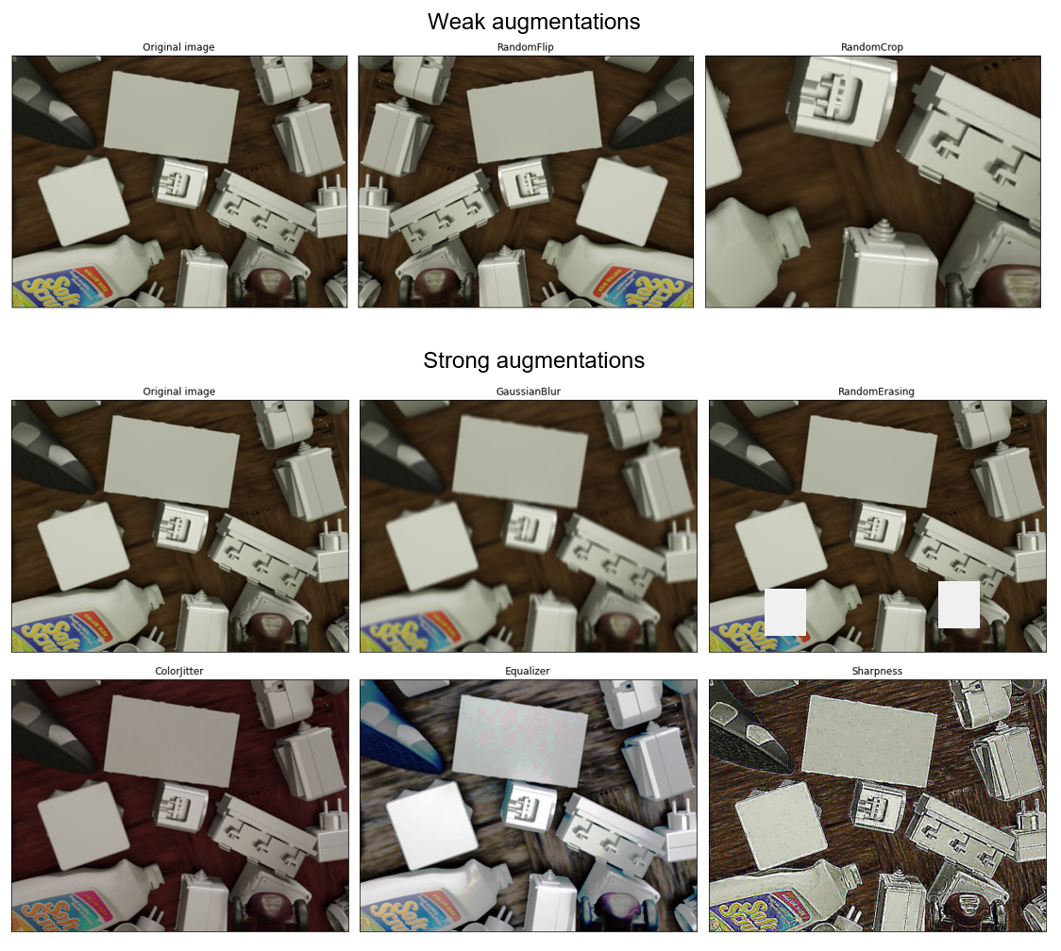
Methodology
Adaptive teacher with additional augmentations
Student model
Teacher model

Slide 17
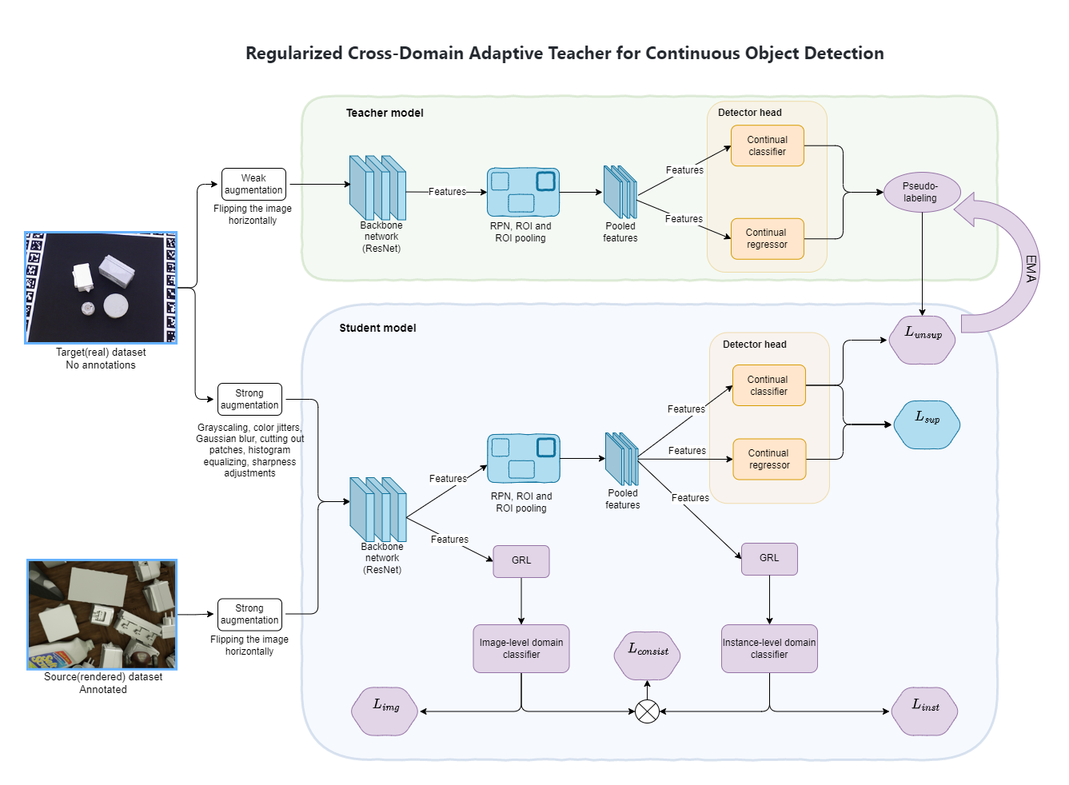
Methodology
Regularized Cross-Domain Adaptive Teacher for Continuous Object Detection
Overall objective:

Slide 18
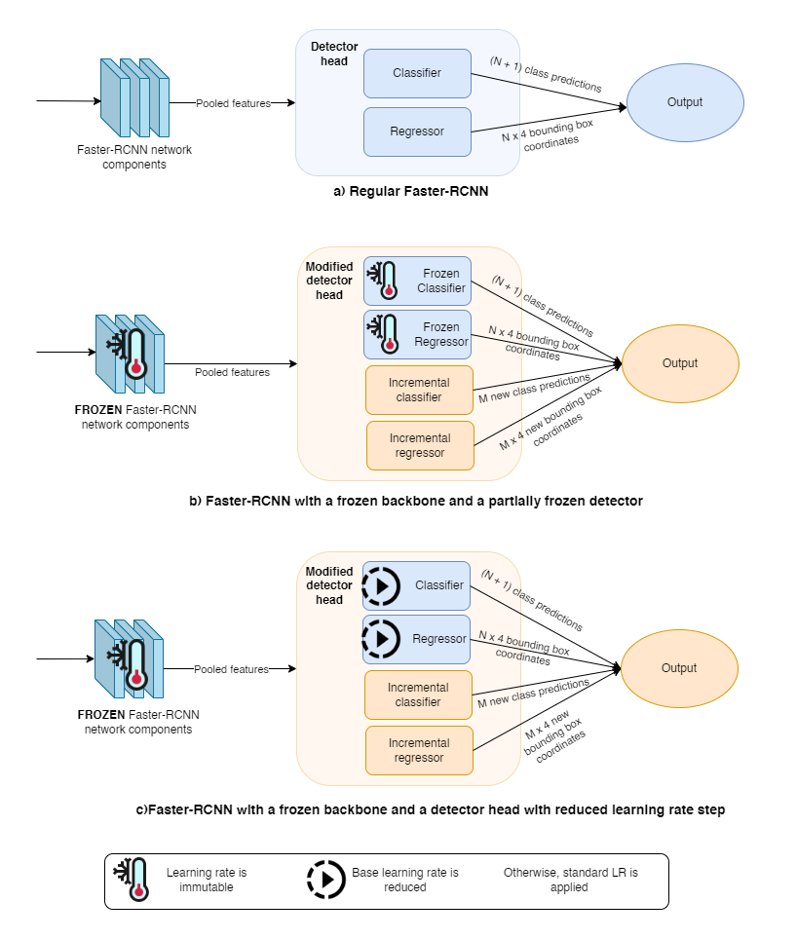
Methodology
Proposed model for continual learning
A. A. Rusu, N. C. Rabinowitz, G. Desjardins, H. Soyer, J. Kirkpatrick, K. Kavukcuoglu, R. Pascanu, and R. Hadsell, “Progressive neural networks,” June 2016.
J. Donahue, Y. Jia, O. Vinyals, J. Hoffman, N. Zhang, E. Tzeng, and T. Darrell, “Decaf: A deep convolutional activation feature for generic visual recognition,” Oct. 2013.

Slide 19
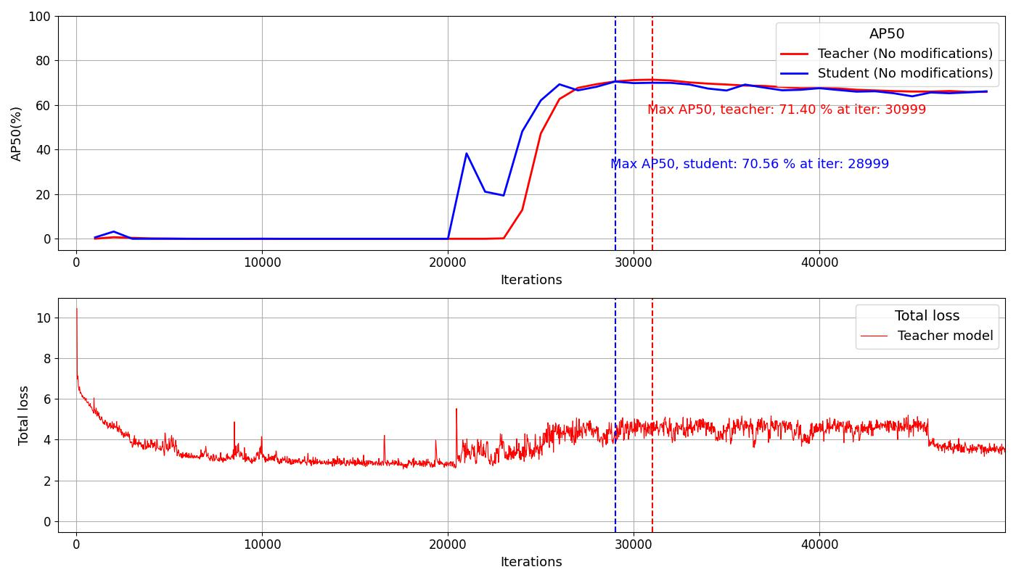
Results, cross-domain adaptation
Original AT model
Key parameters:
Main metrics: AP50% on the teacher model
Base LR = 0.001
Max iterations = 50 000
Evaluation period = 1000

Slide 20
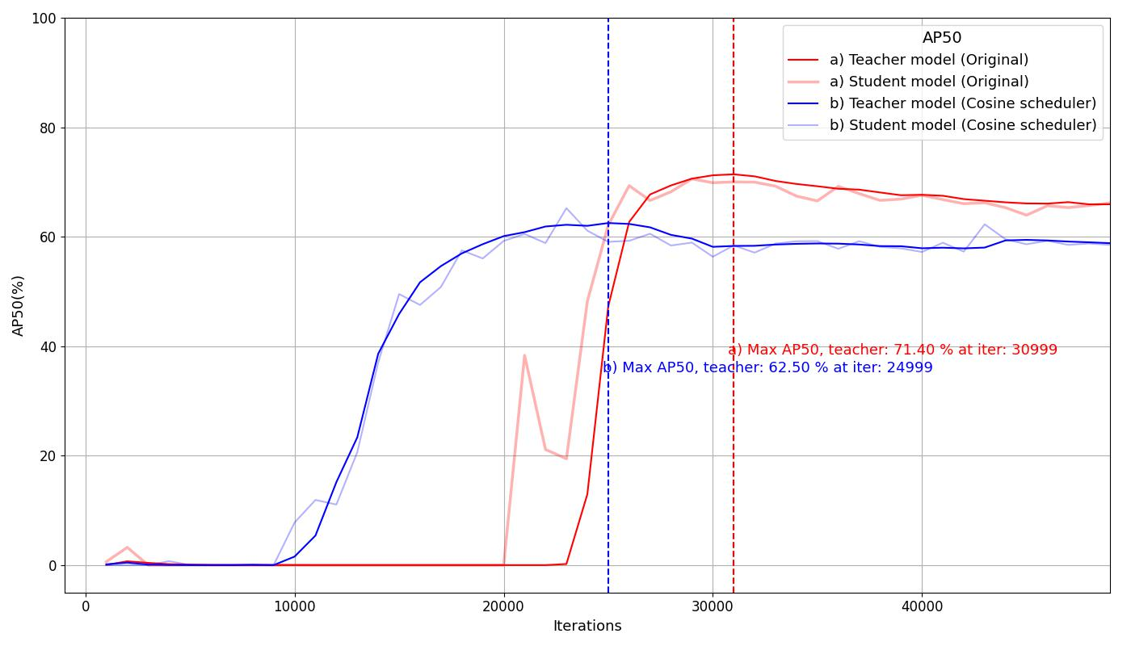
Results, cross-domain adaptation
AT Model with cosine scheduler
Key parameters:
Main metrics: AP50% on the teacher model
Base LR = 0.001
Max iterations = 50 000
Evaluation period = 1000
Components used:
Cosine scheduler

Slide 21
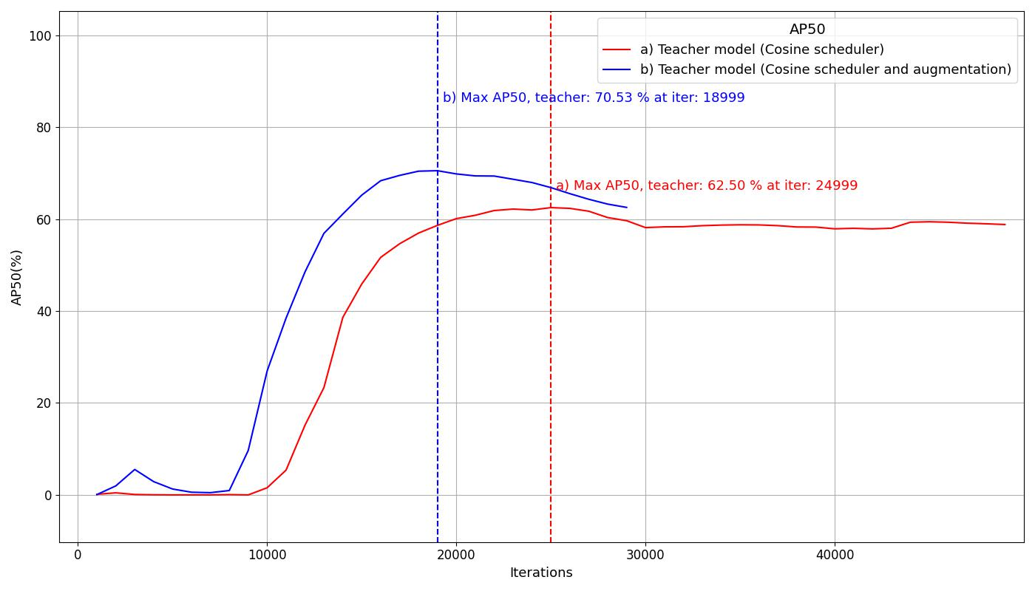
Results, cross-domain adaptation
AT Model with cosine scheduler and augmentations
Key parameters:
Main metrics: AP50% on the teacher model
Base LR = 0.001
Max iterations = 50 000
Evaluation period = 1000
Patience = 10
Components used:
Cosine scheduler
Two augmentations
Early stopping

Slide 22
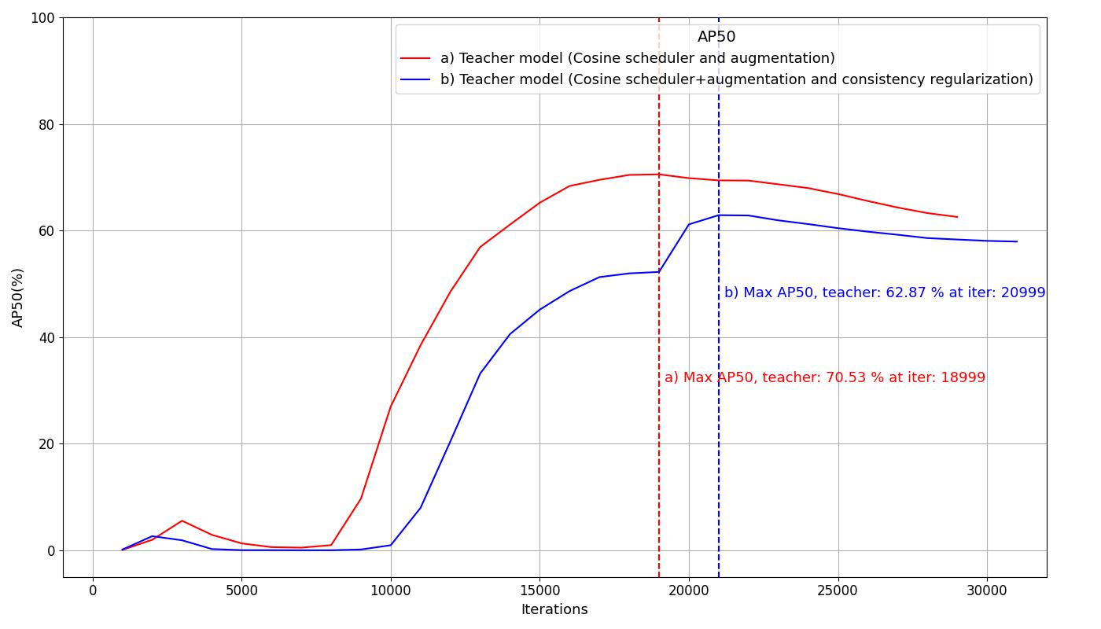
Results, cross-domain adaptation
AT Model with consistency regularization
Key parameters:
Main metrics: AP50% on the teacher model
Base LR = 0.001
Max iterations = 50 000
Evaluation period = 1000
Patience = 10
Components used:
Cosine scheduler
Two augmentations
Early stopping
Consistency regularization

Slide 23
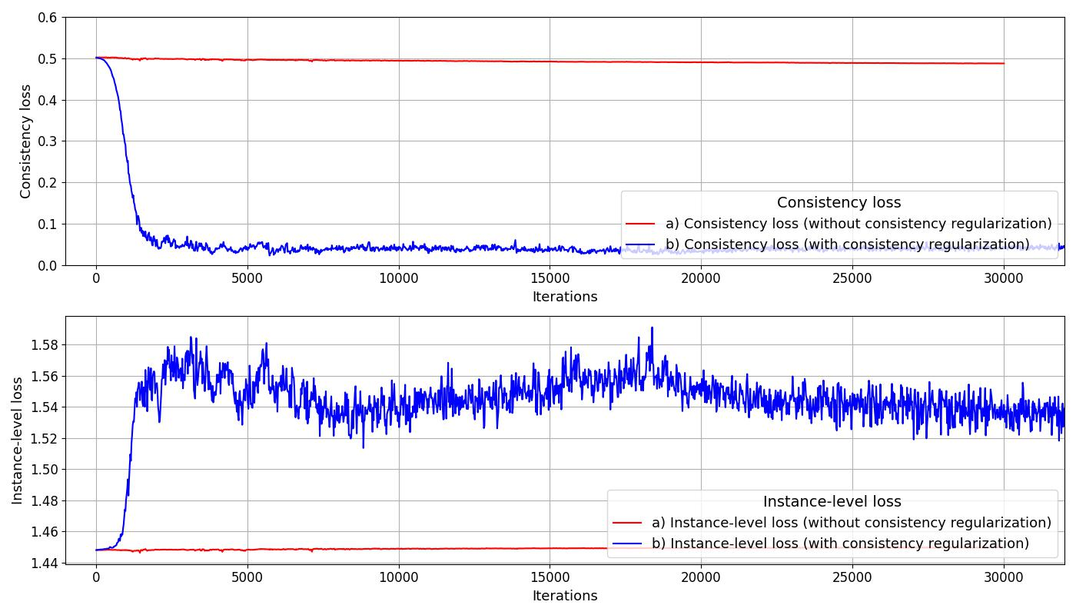
Results, cross-domain adaptation
AT Model with consistency regularization
Key parameters:
Main metrics: AP50% on the teacher model
Base LR = 0.001
Max iterations = 50 000
Evaluation period = 1000
Patience = 10
Components used:
Cosine scheduler
Two augmentations
Early stopping
Consistency regularization (λ=0.07)

Slide 24
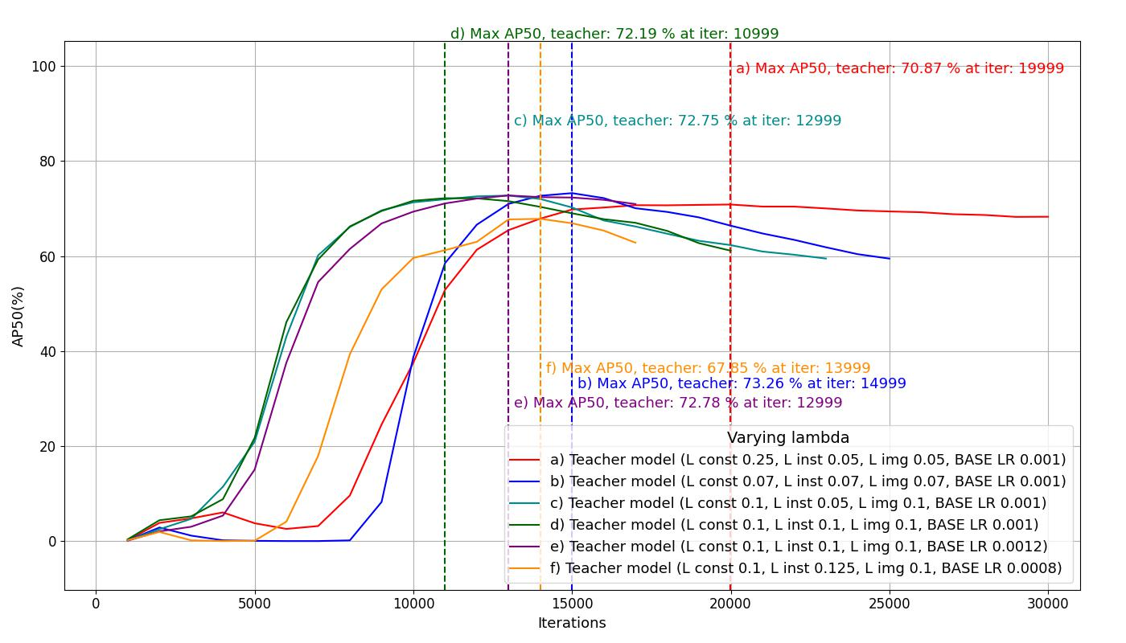
Results, cross-domain adaptation
AT Model with consistency regularization, adjusting λ values
Key parameters:
Main metrics: AP50% on the teacher model
Base LR specified in the plot
Trained on classes 1-20
Max iterations = 30 000
Evaluation period = 1000
Patience = 10
Components used:
Cosine scheduler
Early stopping
Consistency regularization (λ parameters specified in the plot)

Slide 25
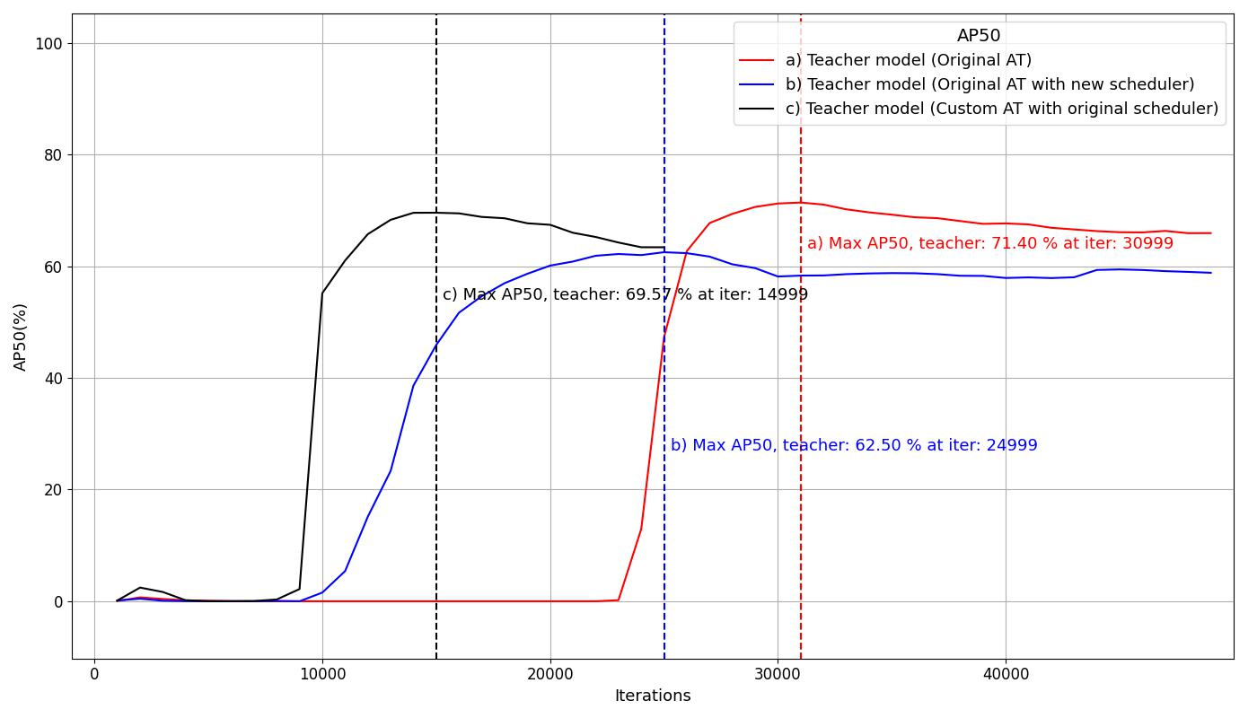
Results, cross-domain adaptation
AT Model with consistency regularization and original scheduler
Key parameters:
Main metrics: AP50% on the teacher model
Base LR = 0.001
Max iterations = 50 000
Evaluation period = 1000
Patience = 10
Components used:
Original scheduler
Two augmentations
Early stopping
Consistency regularization

Slide 26
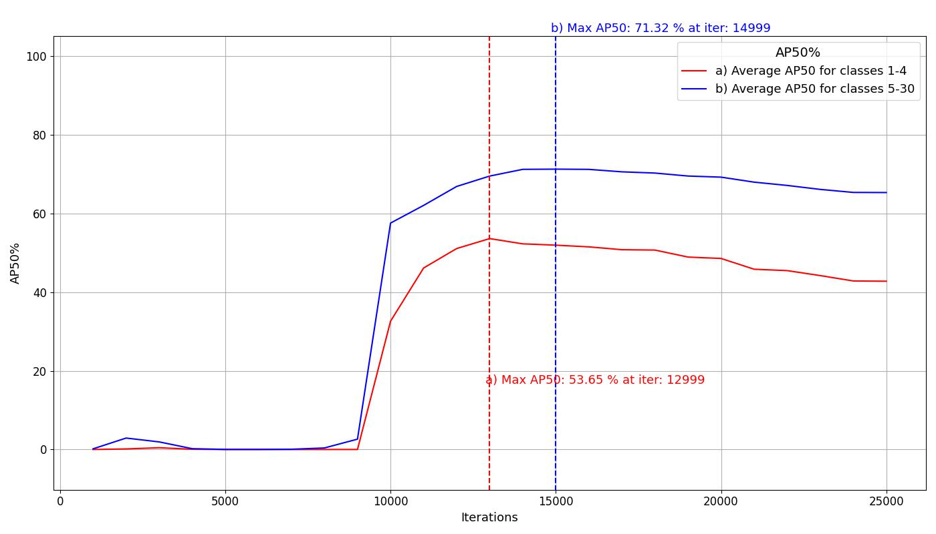
Results, cross-domain adaptation
AT Model, comparing class imbalance
Key parameters:
Main metrics: AP50% on the teacher model
Base LR = 0.001
Trained on classes 1-30
Max iterations = 50 000
Evaluation period = 1000
Patience = 10
Components used:
Original scheduler
Augmentations
Early stopping
Consistency regularization (λ = 0.07)

Slide 27
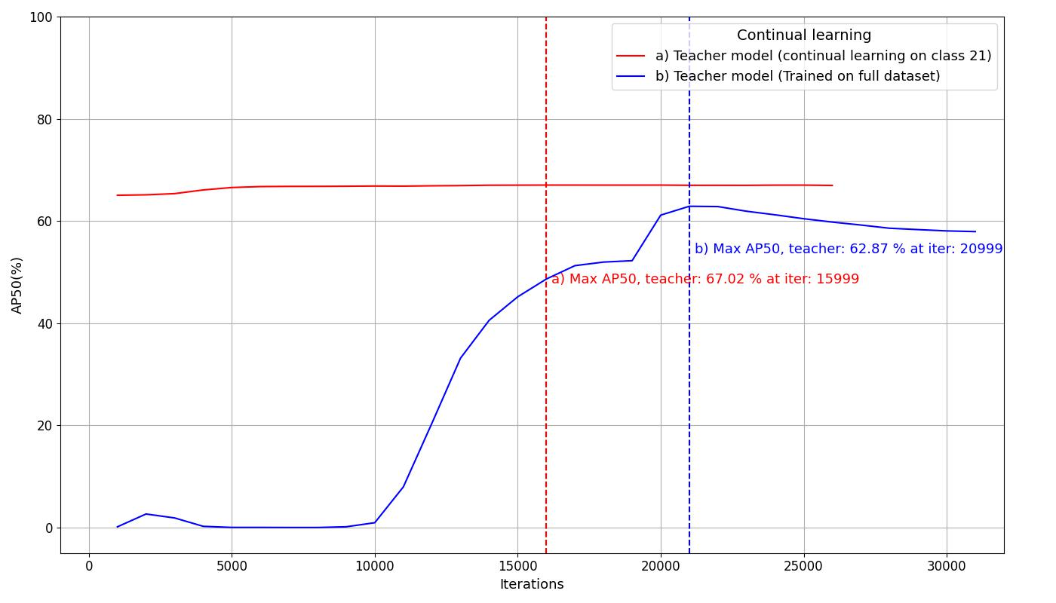
Results, continual learning
Single class, total AP
Key parameters:
Main metrics: AP50% on the teacher model
Base LR = 0.001
LR ratio = 0.001
Max iterations = 50 000
Evaluation period = 1000
Patience = 10
Only class #21 is evaluated
Components used:
Original scheduler
Two augmentations
Early stopping
Consistency regularization

Slide 28
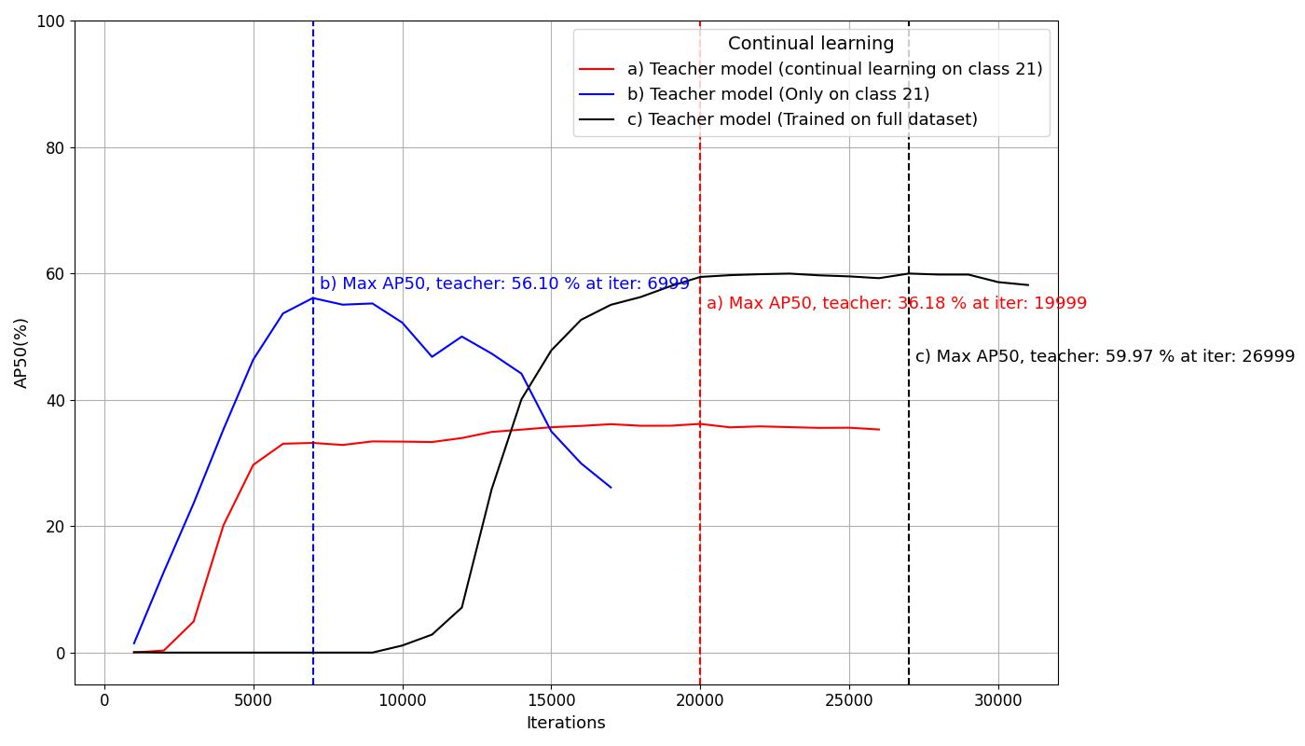
Results, continual learning
Single class, single AP
Key parameters:
Main metrics: AP50% on the teacher model
Base LR = 0.001
LR ratio = 0.001
Max iterations = 50 000
Evaluation period = 1000
Patience = 10
Only class #21 is evaluated
Components used:
Original scheduler
Two augmentations
Early stopping
Consistency regularization

Slide 29
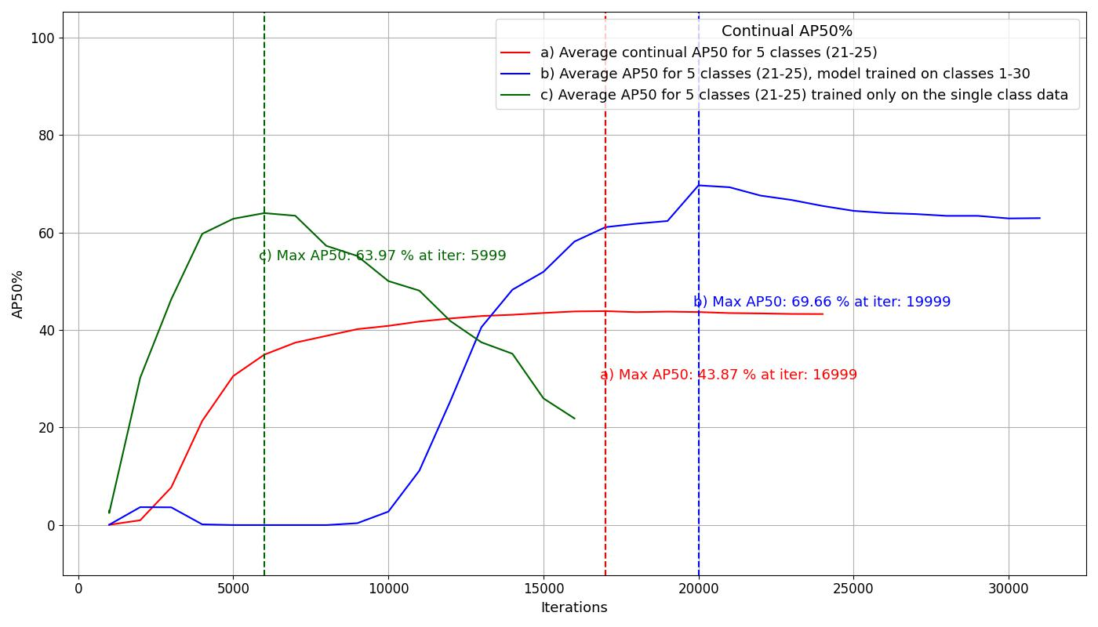
Results, continual learning
Average results for 5 classes
Key parameters:
Main metrics: AP50% on the teacher model
Base LR = 0.001
LR ratio = 0.001
Max iterations = 50 000
Evaluation period = 1000
Patience = 10
Classes #21-25 are evaluated
Components used:
Original scheduler
Two augmentations
Early stopping
Consistency regularization

Slide 30
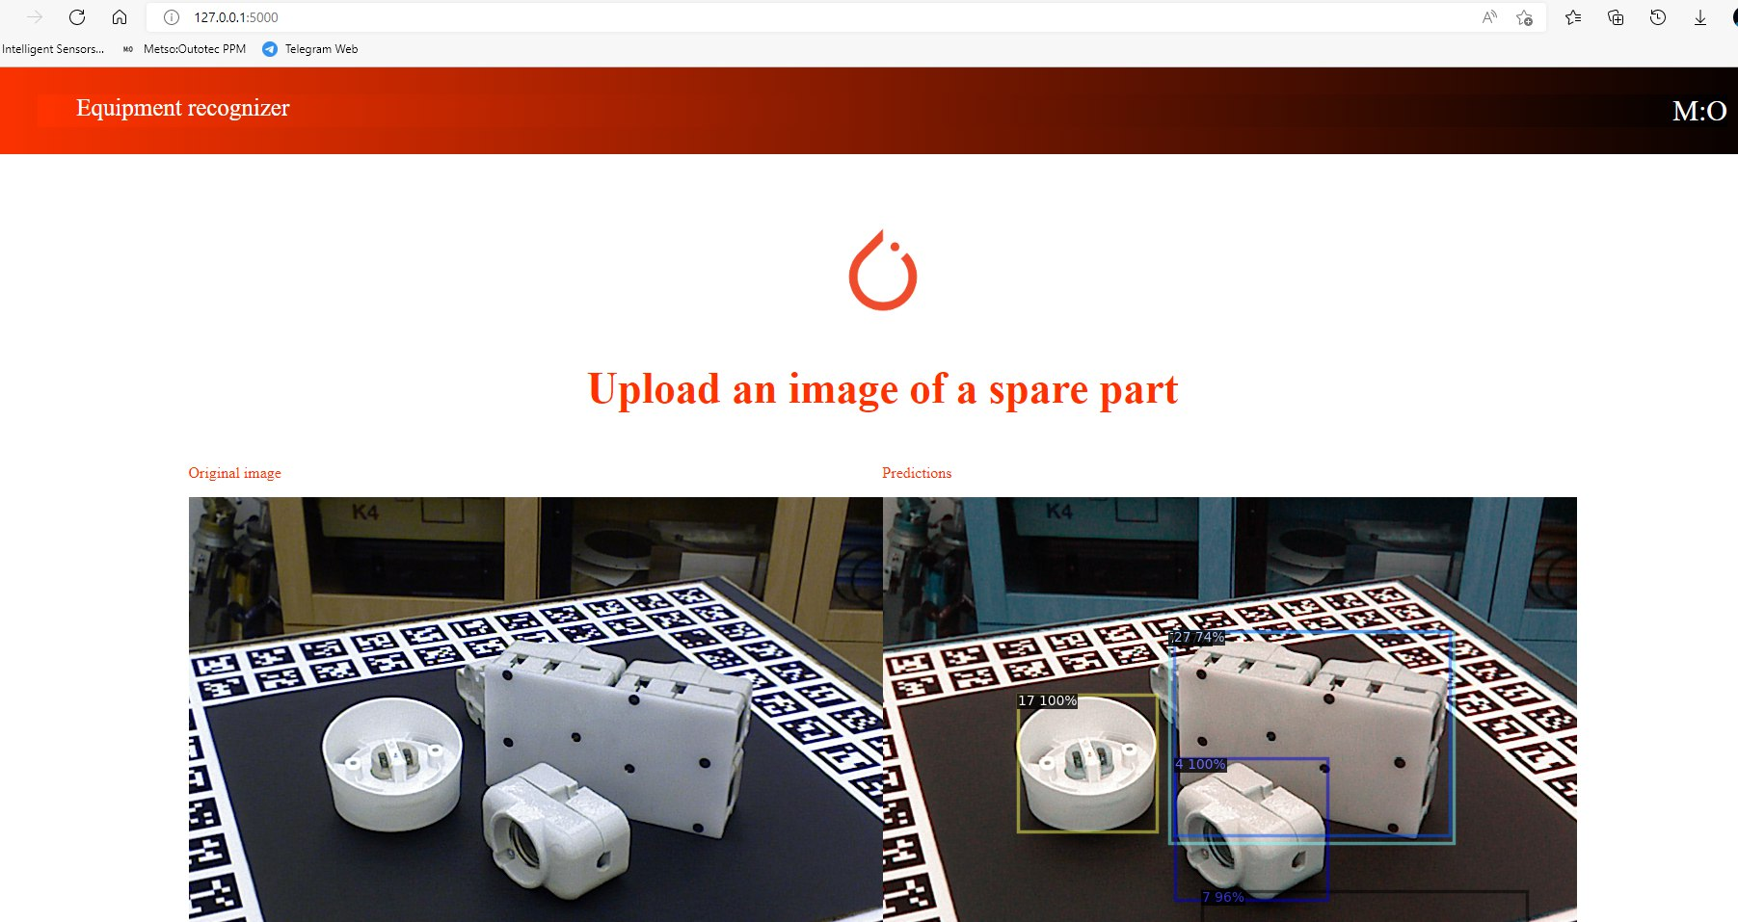
Results
UI prototype
Open-source software used:
Python 3.9
Detectron2 v0.6
Pytorch 1.10.1
CUDA 11.3
Flask API
Hardware used:
Resources provided by CSC Finnish IT Center for Science
GPU: Nvidia A100 (for training)
Upload an image

Slide 31
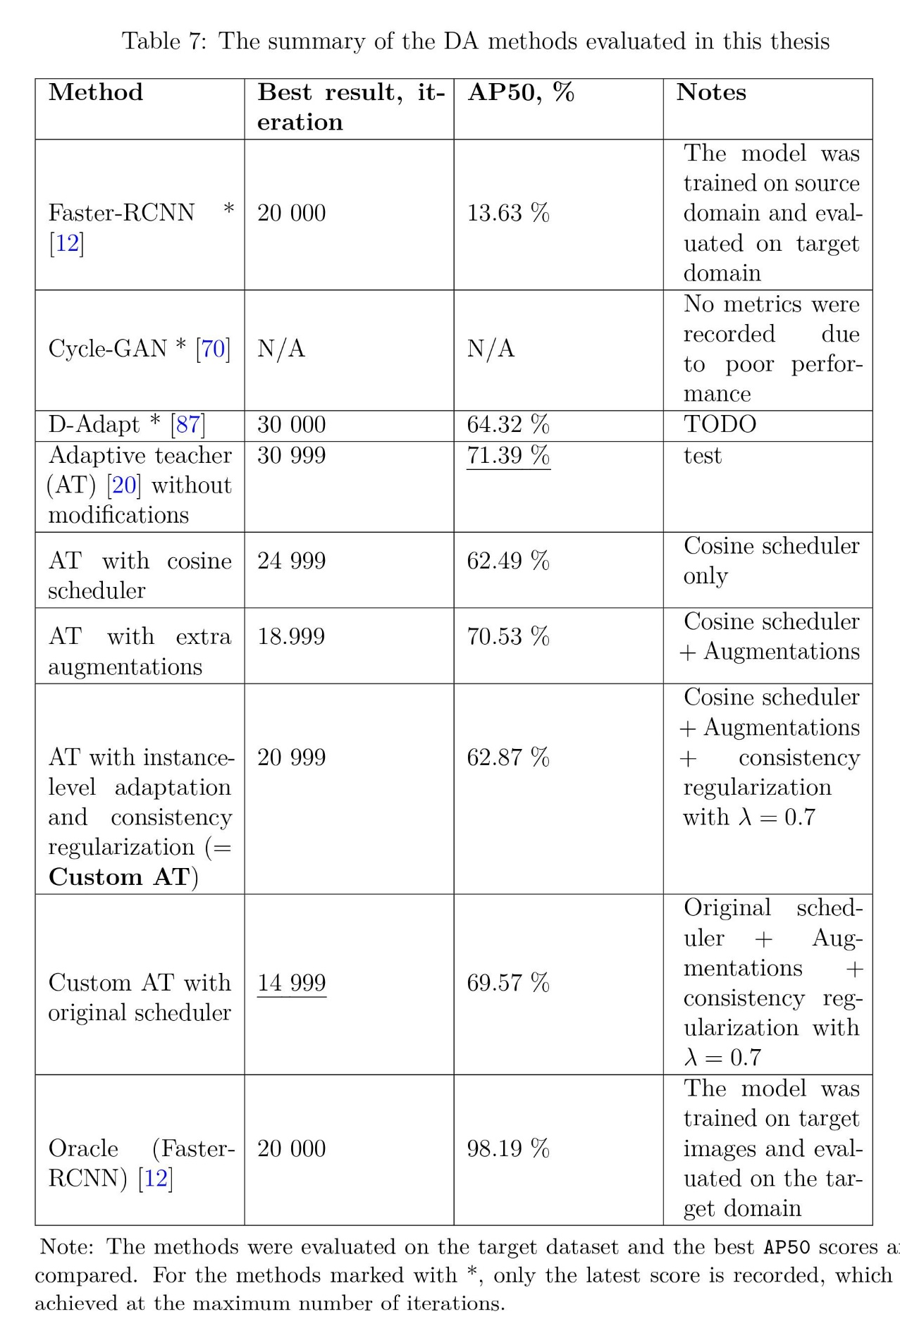
Conclusion
Cross-domain object detection
The original Adaptive teacher model shows the best results
The proposed custom model shows competitive results compared to the original, while also offers a slightly faster training process
The mAP values can be further improved by tweaking the hyperparameters

Slide 32
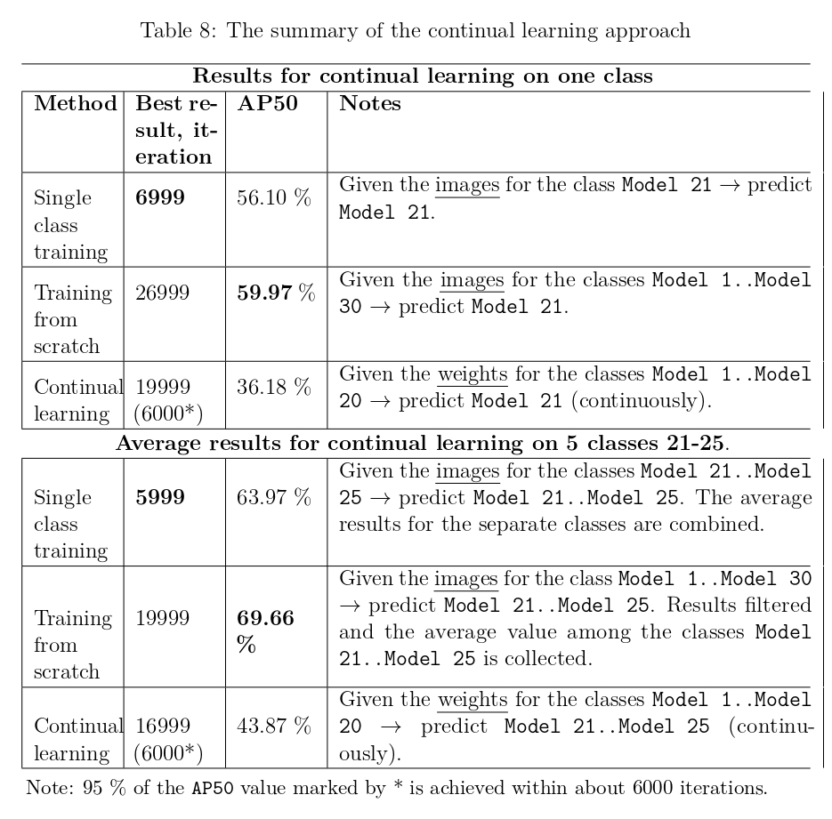
Conclusion
Continual learning model
Training from the scratch shows significantly better results
The proposed continual learning model effectively preserves the old knowledge
Continual learning reaches the saturation AP value in a short time
The AP value is significantly lower than training from the scratch
Deeper parts of the model can be unfrozen to facilitate the feature learning of the added classes

Slide 33
Conclusion
Discussions for future work
Complex datasets
Other detectors
Improved scheduler
Imbalanced classes
Multi-source adaptation
Continual learning
P. Oza, V. A. Sindagi, V. VS, and V. M. Patel, “Unsupervised domain adaptation of object detectors: A survey,” May 2021.

